Slide 1
INTERVIEW METHOD IN RESEARCH Presented by Harish, H.T harishht09@gmail.com

Slide 2
INTERVIEW METHOD IN RESEARCH
INTRODUCTION:
Interview is the verbal conversation between two people with the objective of collecting relevant information for the purpose of research.

Slide 3
DEFINITION
According to McNamara, 1999
Interviews are particularly useful for getting the story behind a participant’s experiences.
The interviewer can pursue in-depth information around the topic.
Interviews may be useful as follow-up to certain respondents.

Slide 4
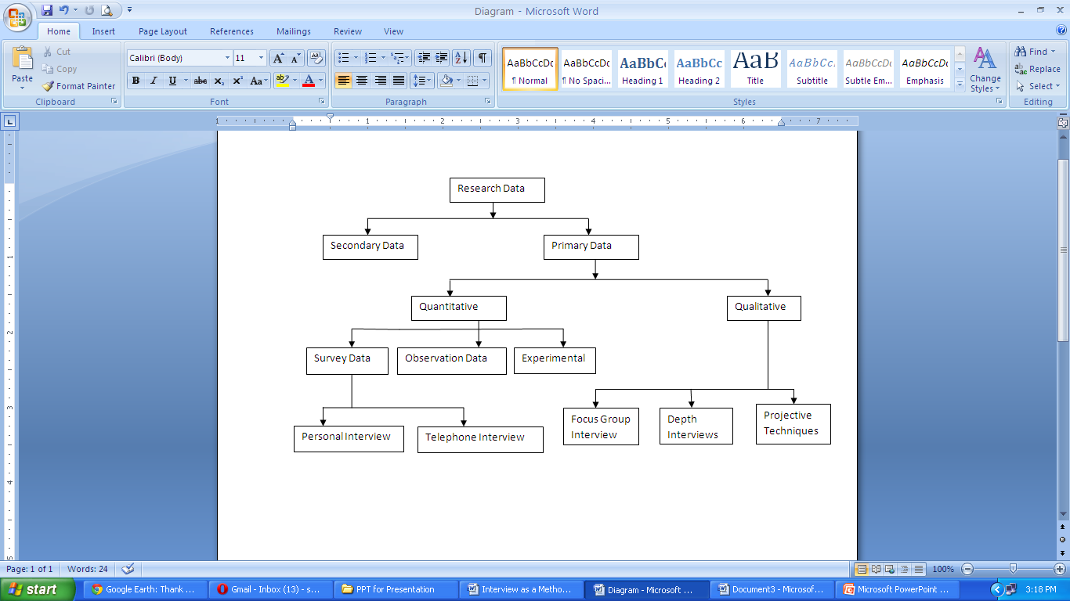
TYPES OF RESEARCH DATA COLLECTION TECHNIQUES

Slide 5
TYPES OF INTERVIEW
1. Personal Interview
2. Telephone Interview
3. Focus Group Interview
4. Depth Interview
5. Projective Techniques

Slide 6
1. Personal Interview
Personal Interview: Is a face to face two way communication between the interviewer and the respondents. Generally the personal interview is carried out in a planned manner and is referred to as ‘structured interview’. This can be done in many forms e.g. door to door or as a planned formal executive meeting.

Slide 7
Methods of conducting an Personal Interview
A personal interview involves a lot of preparation. Generally an personal interview should go through the following five/5 stages they are as follows.

Slide 8
a. Rapport Building
Interviewer should increase the receptiveness of the respondent by making him believe that his opinions are very useful to the research, and is going to be a pleasure rather than an ordeal.

Slide 9
b. Introduction
An introduction involves the interviewer identifying himself by giving him his name, purpose and sponsorship if any. An introductory letter goes a long way in conveying the study’s legitimacy.

Slide 10
c. Probing
Probing is the technique of encouraging the respondents to answer completely, freely and relevantly.

Slide 11
d. Recording
The interviewer can either write the response at the time of interview or after the interview. In certain cases, where the respondent allows for it, audio or visual aids can be used to record answers.

Slide 12
e. Closing
After the interview, interviewer should thank the respondent and once again assure him about the worth of his answers and the confidentiality of the same.

Slide 13
2. Telephone Interview
Telephone interview the information is collected from the respondent by asking him questions on the phone is called as telephone interview. The combination of telephone and computer has made this method even more popular.

Slide 14
3. Focus Group Interview
Focus group interview is an unstructured interview which involves a moderator leading a discussion between a small group of respondents on a specific topic.
Focus group interview results in advantages summed up as 10 S. they as follow.
Synergism
Snowballing

Slide 15
Cont.
Stimulation
Security
Spontaneity
Serendipity
Specialization
Scientific scrutiny
Structure
speed

Slide 16
4. Depth Interview
Depth interview is nondirective in nature where the respondent is given freedom to answer within the boundaries of the topic of interest.

Slide 17
5. Projective Techniques
Projective Techniques involve the presentation of an ambiguous, unstructured object, activity or person that a respondent is asked to interpret and explain.
In Projective Techniques, the respondents are asked to interpret the behaviour of others and this way they indirectly reveal their own behaviour in the same situation. Some of these techniques are discussed below.

Slide 18
Cont..
Word Association Test: Respondents are presented with a list of words one at a time and they are asked to respond immediately with the first things that come to their mind e.g. in a study on book reading habits the respondents can be presented with words like 2 states etc.
Cloud Picture Test: This shows two or more character conversing with each other and cloud of one character is left empty as a response to be filled by the respondents according to his interpretation of what the other characters are saying.

Slide 19
Cont..
Sentence Completion Test: It is similar to a word association test where instead of a word, a sentence is left incomplete and the respondent is asked to fill it with the first thought that comes to his mind e.g. People who enter politics are……………………..
Story Completion Study: A step further to sentence completion, is the story completion study: Under this a story is created by the researcher which defines the topic of research and the respondents are asked to complete the story.

Slide 20
Advantages of Interview Method
Opportunity for Feedback – Interviewer can provide direct feedback to the respondent, give clarifications and help alleviate any misconceptions or apprehensions over confidentiality that the respondent may have in answering the interviewer’s questions
Probing Complex Answers – Interviewers can probe if the respondent’s answer is too brief or unclear. This gives interviewers some flexibility in dealing with unstructured questions and is especially suited for handling complex questions
Length of Interview – If the questionnaire is very lengthy, the personal interview is the best technique for getting respondents to cooperate, without overtaxing their patience

Slide 21
Cont..
4. Complete Questionnaires – Personal ensures ensure that the respondent will answer all questions asked, unlike in telephone interview where the respondent may hang up or in mail questionnaire where some questions may go unanswered
5. Props & Visual Aids – Interviewers have the opportunity of showing respondents items such as sample products, graphs ands sketches, which can aid in their answers
6. High Participation – Interviewing respondents personally can increase the likelihood of their participation, as many people prefer to communicate directly verbally and sharing information and insights with interviewers

Slide 22
Disadvantages of Interview Method
Cost – Personal interviews are usually more expensive than mail, telephone and internet surveys. Factors influencing the cost of the interview include the respondents’ geographic proximity, the length and complexity of the questionnaire, and the number of non-respondents
Lack of Anonymity – Respondents are not anonymous in a personal (face-to-face) interview and may be reluctant to disclose certain information to the interviewer. Hence, considerable must be expended by the interviewer when dealing with sensitive questions to avoid bias effects on the respondent’s part
Necessity for Callbacks – When a person selected for interview cannot be reached the first time, a callback has to be scheduled which result in extra cost and time spent

Slide 23
Cont..
4.Variance Effects – It has been shown that the demographic characteristics of the interviewer can influence the answers of the respondents. In one study, male interviewers had a much larger variance of answers than female interviewers in a sample of most female individuals
5. Dishonesty – Interviewers cheat to make their life easier and save time and effort
6. Personal Style – The interviewers individual questioning style, techniques, approach and demeanor may influence the respondents’ answers
7. Global Considerations – Cultural aspects may influence peoples’ willingness to participate in an interview (e.g. repressive Middle Eastern cultures discourage females from being questioned by male interviewers)

Slide 24
Conclusion
So we can use the interview technique as one of the data collection methods for the research.
It makes the researcher to feel that the data what he collected is true and honest and original by nature because of the face to face interaction.

Slide 25
Bibliography
Kothari, C.R. (2009). Research methodology. New Delhi: New Age International.
Krishhnaswami, O.R., & Ranganatham, M. (2009). Methodology of research in social sciences. Mumbai: Himalaya Publishing House.
Panneerselvam, R. (2008). Research methodology. New Delhi: Prentice Hall of India.
Ramachandra.. Chandrashekara., & Shivakumar. (2006). Business Research Methods. Mumbai: Himalaya Publishing House.
Gupta, Shashi., & Rangi, Praneet. (2010). Business Research Methods. New Delhi: Kalyani Publishers.
http://www.public.asu.edu/~kroel/www500/Interview%20Fri.pdf

